Slide 1
Class Inheritance vs Interface inheritance

Slide 2
Class vs Interface
A class = an objects implementation:
Defines how an objects operations are implemented
Defines an objects internal state
An Interface = an object’s type:
Defines the set of requests an object can respond to
Objects can have many types
Objects of different classes can have the same type.

Slide 3
Class Inheritance vs Interface Inheritance
Class Inheritance:
Defines an object’s implementation in terms of another object’s implementation
Interface Inheritance:
Describes when an object can be used in place of another.

Slide 4
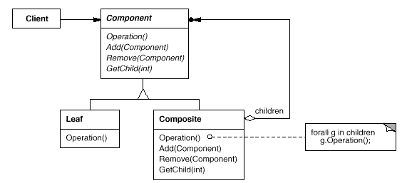
Example: Composite
In the Composite pattern, Component defines a common interface, but Composite often defines a common implementation.

Slide 5
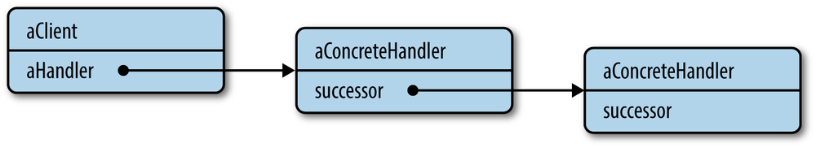
Example: Chain of responsibility
Conversely, objects in a Chain of Responsibility must have a common type, but usually they don’t share a common implementation.

Slide 6
Other Examples
Command, Observer, State, and Strategy patterns are often implemented with abstract classes that are pure interfaces.

